Slide 1
Image Classification Optimization
How to improve image classification model performance from data augmentation and model structure?
Presenters: Mengzhi Zhou, Guanzhi Wang

Slide 2
Introduction
Definition
Applications
Methods
Problem

Slide 3
The task of extracting information classes from a multiband raster image.
A process in computer vision that can classify an image according to its visual content.

Slide 4


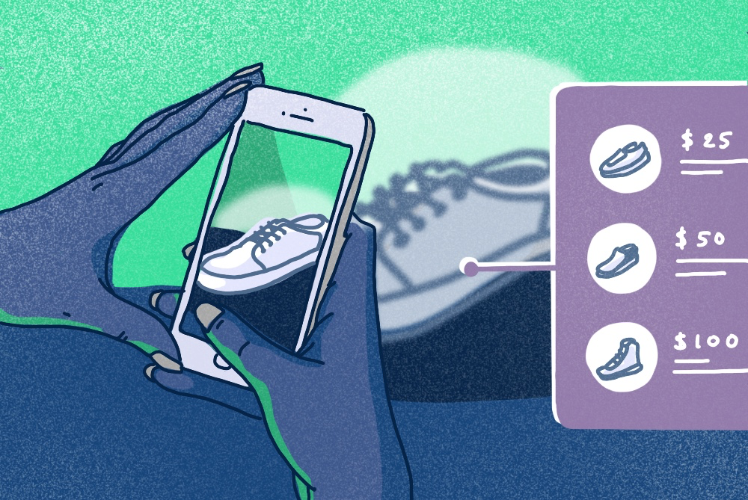
Face ID
Instagram filters
Visual search
Etc...

Slide 5
SVMs
Decision trees
Neural networks
Bayesian, Markov chain Monte Carlo, etc...

Slide 6
How to improve image classification model accuracy while keeping fast-paced data processing speed?

Slide 7
Related Work

Slide 8
Anne Bonner gave a basic overview for image classification and CNN. She talked about the foundation of CNN and image classification, logics behind models, basic structure of CNN, etc.
Le and James presented a performance comparison between image classification models with MNIST dataset.
Wang and Luis illustrated an experiment to compare impact of different data augmentation techniques: traditional transformation, generative adversarial networks, and neural net augmentation.

Slide 9
Fong and Andrea mentioned photographer bias, which can strongly affect neural network performance. They discussed about occlusion augmentation techniques: batch augmentation, joint training and dropout method, and set up an experiment to compare those occlusion augmentation effects.
Vailaya, Figueiredo, Jain and Zhang modified the binary Bayesian classifiers that achieved classification accuracy that higher than 90% for all four classification problems with database of 6931 photos.

Slide 10
McCann and Lowe created the Local Naive Bayes Nearest Neighbor.
Zhou, Cui, Li, Liang and Huang discussed about the hierarchical Gaussian mixture model whose parameters are learned in a Bayesian framework that is useful in image classification .

Slide 11
Data

Slide 12
From Kaggle
25,000 RGB images
Two classes: cat and dog
Labeled

Slide 13
Irrelevant images dropped
Random subset method applied
Use GPU rather than CPU

Slide 14
Methods
Horizontal and vertical comparison among image classification models

Slide 15
5 Different Image Classification Models
Baseline model: 1 convolution layer + no data augmentation process
DA model: 1 convolution layer + data augmentation process
3CNN model: 3 convolution layers + no data augmentation process
3CNN + DA model: 3 convolution layers + data augmentation process
Pretrained model: VGG16 image classification model (ImageNet)

Slide 16
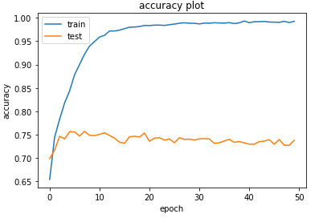
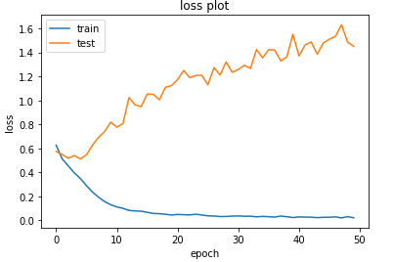
1. Baseline Model
Model Structure:
1 convolution layer with 32 filters, relu activation function, 0.3 dropout rate, adam as optimizer
No data augmentation process

Slide 17
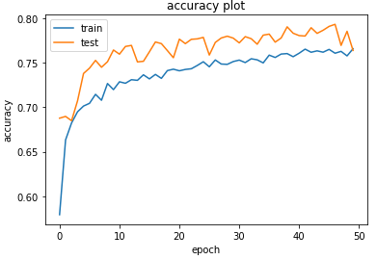
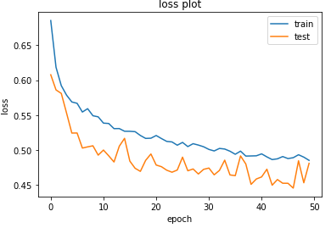
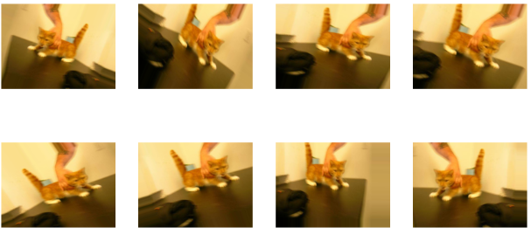
2. DA Model
Model Structure:
Same as baseline model
Data augmentation process:
Rotation, width and height shift, shearing, horizontal flip and zoom

Slide 18
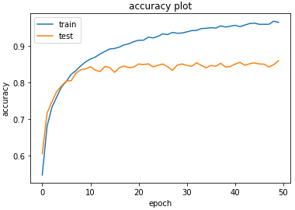
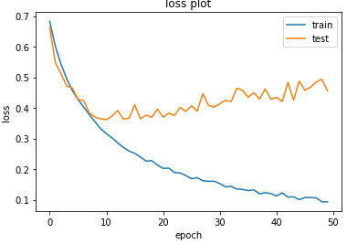
3. 3CNN Model
Model Structure:
3 convolution layers with up to 128 filters, relu activation function, 0.3 dropout rate, adam as optimizer
No data augmentation process

Slide 19
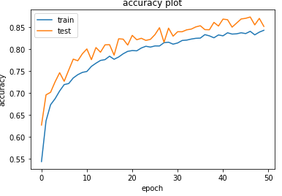
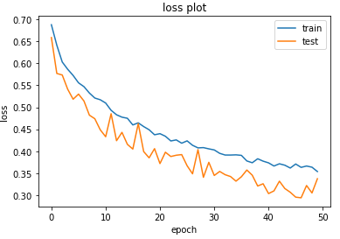
4. 3CNN + DA Model
Model Structure:
Same as 3CNN model
Data augmentation process:
Same as DA model

Slide 20
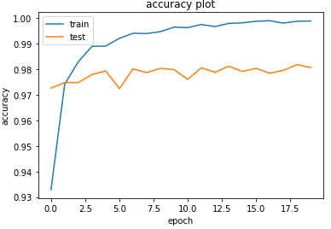
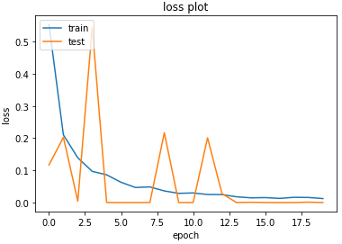
5. Pretrained Model
VGG16 model (transfer learning)
Based on ImageNet dataset：
Include over 1000 categories with animal, plant, sports, material, food, etc.

Slide 21
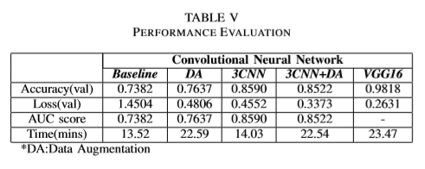
Overall Performance Comparison
Except pretrained model, 3CNN+DA model has the best overall performance
Pretrained model has highest accuracy among 5 image classification models

Slide 22
Conclusion
What is the effect of data augmentation and neural network structure on model performance?
Data augmentation process could avoid overfitting problem but substantially slow down processing speed of model
As complexity of neural network structure increase, model gets stronger computation ability but also greater potential risk for overfitting problem.
The cooperation between data augmentation and neural network structure is significant for image classification model performance!

Slide 23
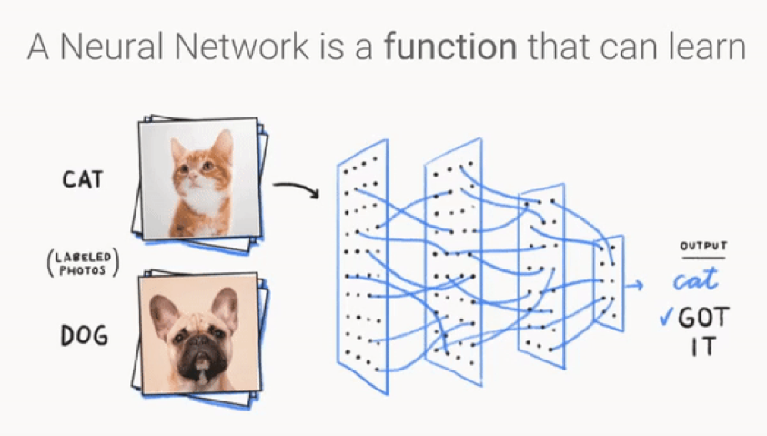
Future Research
Parameter tuning: filter number, dropout rate, etc.
Improve neural network structure
Developing Bayesian framework
Different optimizer comparison: adam, SGD, ADA, etc.
Explore effect of each data augmentation components separately

Slide 24
Reference
Buyya, R., Calheiros, R. N., Dastjerdi, A. V. (Eds.). (2016). Big data: principles and paradigms. Morgan Kaufmann.
Vailaya, A., Figueiredo, M. A., Jain, A. K., Zhang, H. J. (2001). Image classiﬁcation for content-based indexing. IEEE transactions on image processing, 10(1), 117-130.
Bonner, Anne. “The Complete Beginner’s Guide to Deep Learning: Convolutional Neural Networks.” Medium, Towards Data Science, 1 June 2019, towardsdatascience.com/wtf-is-image-classiﬁcation8e78a8235acb.
Le, James. “The 4 Convolutional Neural Network Models That Can Classify Your Fashion Images.” Medium, Towards Data Science, 7 Oct. 2018, towardsdatascience.com/the-4-convolutional-neural-networkmodels-that-can-classify-your-fashion-images-9fe7f3e5399d.
Wang, Jason, and Luis Perez. “The Effectiveness of Data Augmentation inImageClassiﬁcationUsingDeepLearning.”TheEffectivenessofData Augmentation in Image Classiﬁcation Using Deep Learning, 13 Dec. 2017.
Fong, Ruth, and Andrea Vedaldi. “Occlusions for Effective Data Augmentation in Image Classiﬁcation.” 2019 IEEE/CVF International Conference on Computer Vision Workshop (ICCVW), 23 Oct. 2019, doi:10.1109/iccvw.2019.00511.
McCann, S., Lowe, D. G. (2012, June). Local naive bayes nearest neighbor for image classiﬁcation. In 2012 IEEE Conference on Computer Vision and Pattern Recognition (pp. 3650-3656). IEEE.
Zhou, X., Cui, N., Li, Z., Liang, F., Huang, T. S. (2009, September). Hierarchical gaussianization for image classiﬁcation. In 2009 IEEE 12th International Conference on Computer Vision (pp. 1971-1977). IEEE.
”Dogs vs. Cats Kaggle”, Kaggle.com, 2020. [Online]. Available: https://www.kaggle.com/c/dogs-vs-cats/overview.
Sarkar. (2018, November 17). A Comprehensive Hands-on Guide to Transfer Learning with Real-World Applications in Deep Learning. Retrieved from https://towardsdatascience.com/a-comprehensive-handson-guide-to-transfer-learning-with-real-world-applications-in-deeplearning-212bf3b2f27a

Slide 25
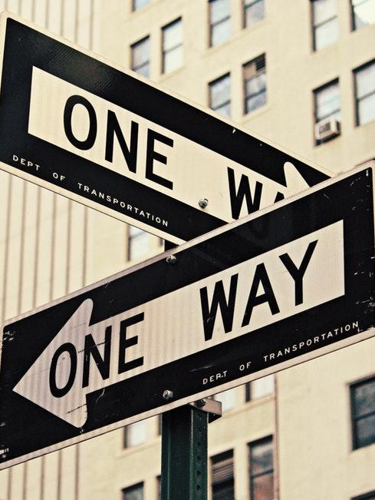
THANKS!
Any questions?

